Slide 1

“In the name of Allah, The Most Gracious and The Most Merciful“.
شُروع اَللہ کے پاک نام سے جو بڑا مہر بان نہايت رحم والا ہے

Slide 2

Computer Organization and Architecture Project
HOME AUTOMATION PROJECT
Group Members: | Enrollment
Shehroz Ashraf khan | 03-134202-080
Muhammad Ameer Hamza | 03-134202-043
Muhammad Haseeb Akber | 03-134202-052
Department of Computer Sciences, Bahira University Lahore Campus, Lahore

Slide 3
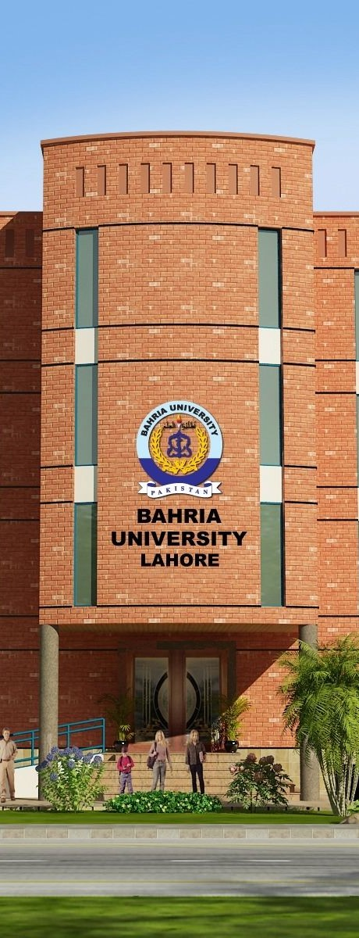
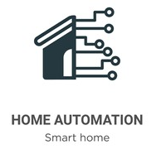
Outline
Introduction
Methodology
Circuit
Components
Input/output of Circuit
Cost of Project
References

Slide 4
Introduction
This project is based on the construction of a model simulating a home automation with different operation modes which can be controlled also by a mobile application.
This is the result of the connection of two modern technologies, including hardware and software. Despite the actuality of these components, they all appeared long ago and have been evolving throughout history.
The prototype on which this project is based can be controlled from a customized mobile application. A mobile application is a computer application designed to be executed on smartphones, tablets and other mobile devices which allows the user to perform specific tasks of any kind

Slide 5
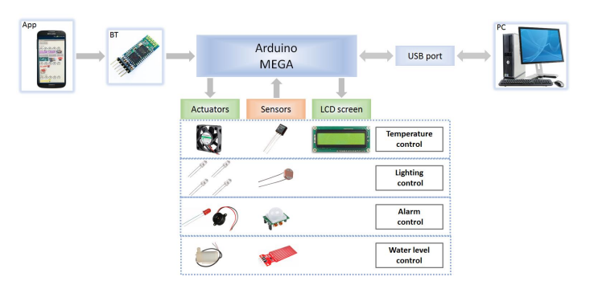
Methodology

Slide 6
Circuit
A) connections between Bluetooth module and arduino
+5v(arduino) to +5v(bluetooth)
Gnd(arduino) to gnd(bluetooth)
Rx(arduino) to tx(bluetooth)
Tx(arduino) to rx(bluetooth)
B) connections between relay and arduino
+5v(arduino) to vcc(relay)
Gnd(arduino) to gnd(relay)
Digital pin 8(arduino) to in1(relay)
Digital pin 9(arduino) to in2(relay)
C) connections between relay, switch board and bulb
No(normally open) pin(relay) to bulb-1
Common pin(relay) to switch board(switch-1)
No(normally open) pin(relay) to bulb-2
Common pin(relay) to switch board(switch-2)
Gnd(bulb-1) to GND(AC supply - negative terminal)
Gnd(bulb-2) to GND(AC supply - negative terminal)
Switch board(switch-1) to AC supply - positive terminal
Switch board(switch-2) to AC supply - positive terminal

Slide 7
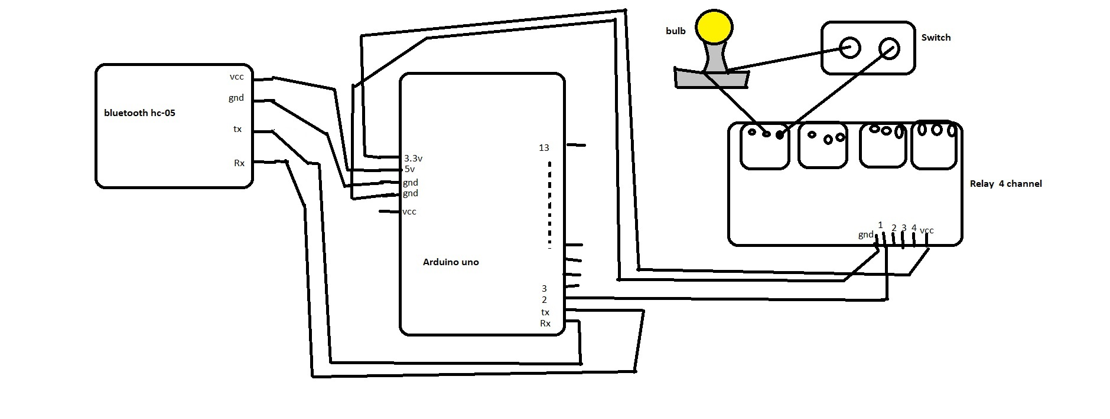
Circuit

Slide 8
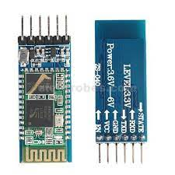
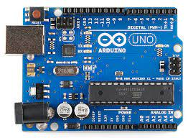
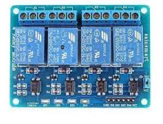
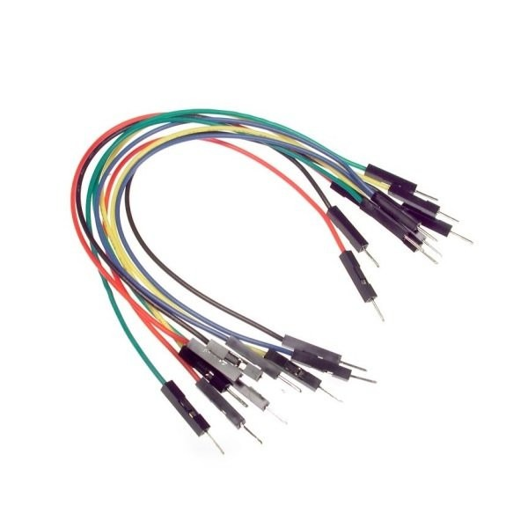
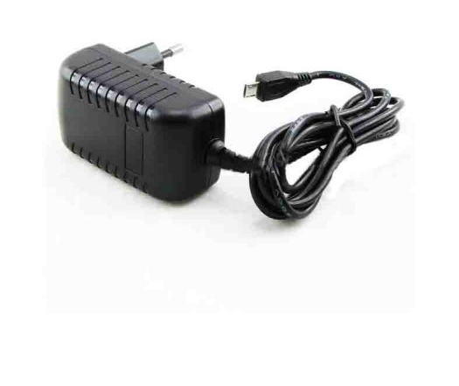
Component’s
Arduino UNO
5V 4 Channel Relay
5V Adapter
HC – 05 Bluetooth Module
Jumper Wires

Slide 9
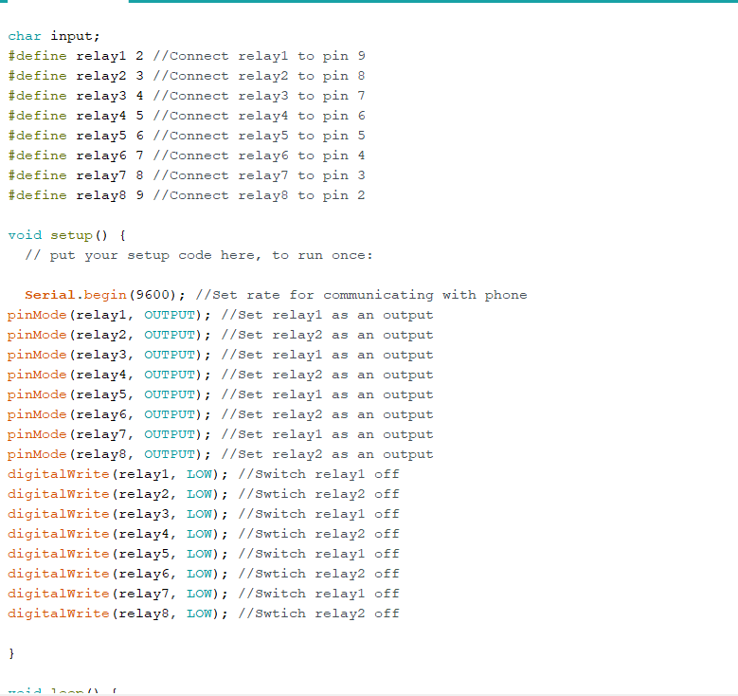
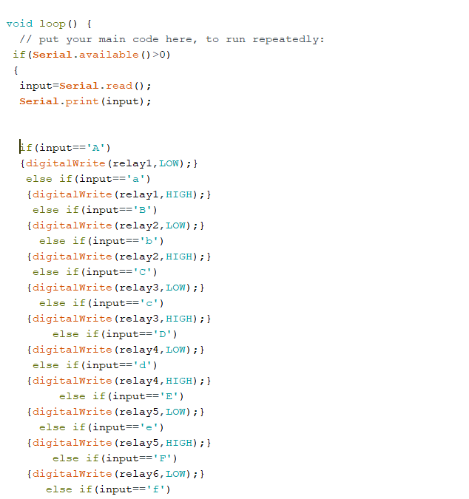
Input/Output of Circuit

Slide 10
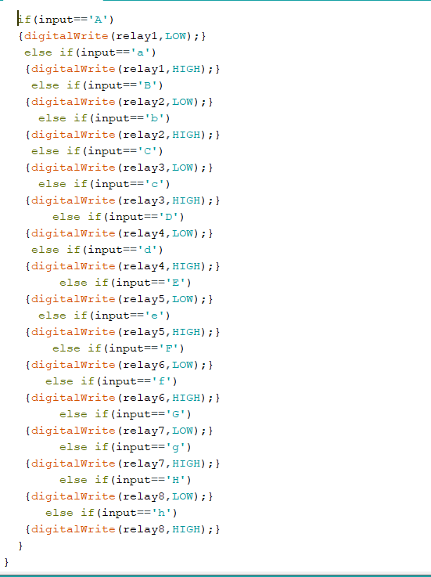
Input/Output of Circuit

Slide 11
Cost of Project
Component | Price
Arduino UNO | Rs. 1350
5V 4 Channel Relay | Rs. 00
5V Adapter | Rs. 200
HC – 05 Bluetooth Module | Rs. 500
Jumper Wires | Rs. 100
Total Cost : Rs. 3000/-

Slide 12
Reference
YouTube
Website 1 :
https://create.arduino.cc/projecthub/171916/bluetooth-controlled-home-light-9447d8
Website 2 :
https://drive.google.com/file/d/1UGmxArnKH-WmziKLx0BxqJ3cWIbF4_jq/view

